Slide 1
Life Management Mobile App 2.0
Team Members:
Product owner:
Instructor:
Lazaro Fernandez, Natalia Filippova, Eric Rado
Ranjeet Deshmukh
Masoud Sadjadi

Slide 2
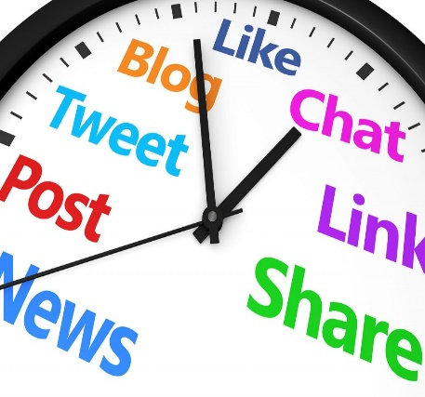


PROBLEM
Many people feel lack of purpose, fulfillment and contentment
People spend time on things that do not really matter
There is a need to help people find happiness and meaning in life
Distractions from things that make you happy
Feel unsatisfied and empty deep inside
Need to find happiness and meaning in life

Slide 3



SOLUTION
Help people progressively discover and build a better version of themselves through:
Find JOY in what you do
Do things you are PASSIONATE about
Find a way to GIVE BACK to others

Slide 4
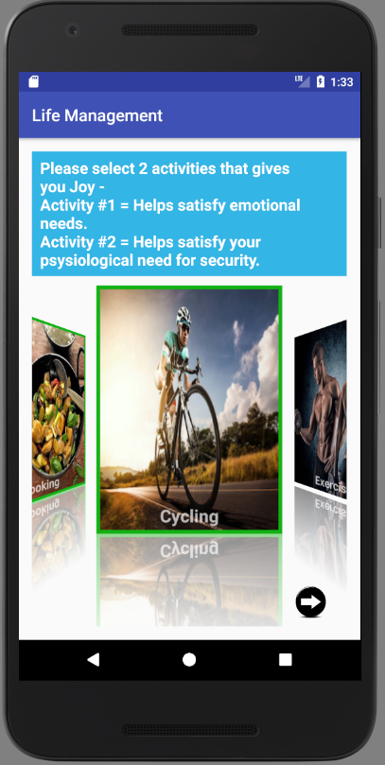
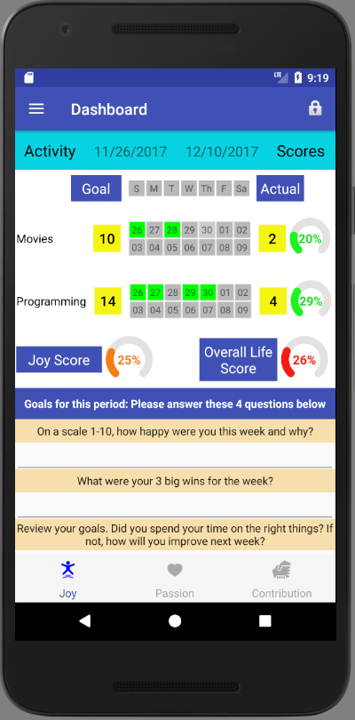
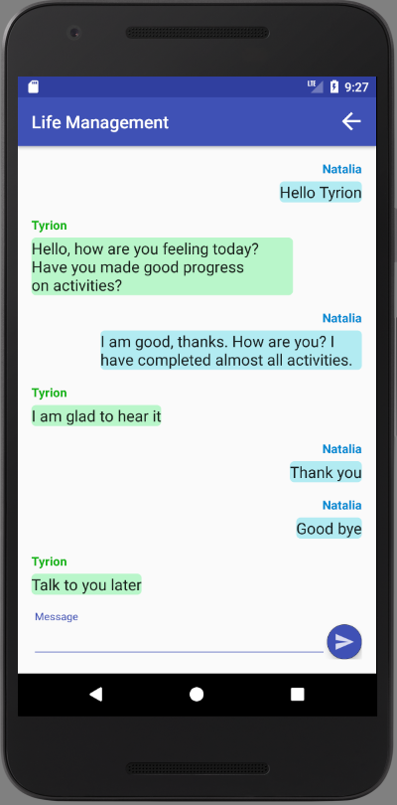
Life Management Mobile App
Helps people to stay focused on activities that help find a sense of joy, passion and contribution
Activities Selection
Dashboard
Coach Support

Slide 5
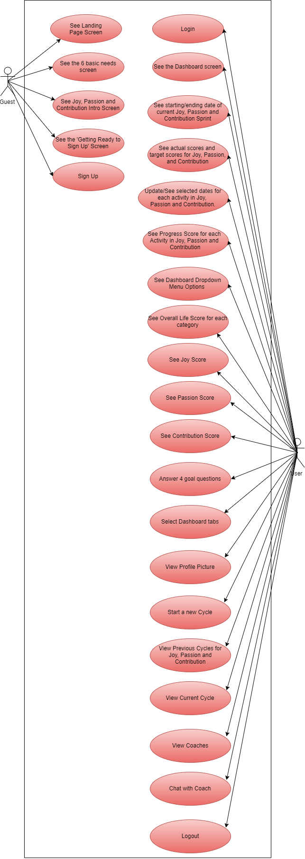
Requirements: Use Case Diagram

Slide 6
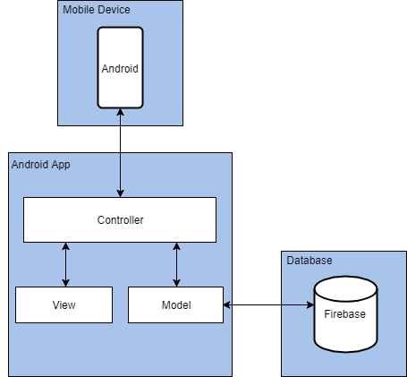
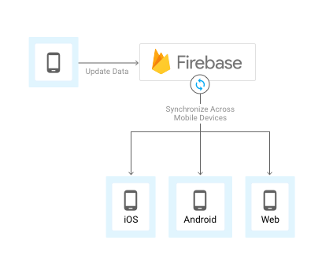
System Design
The system was developed using Model-View-Controller (MVC) architectural pattern:

Slide 7
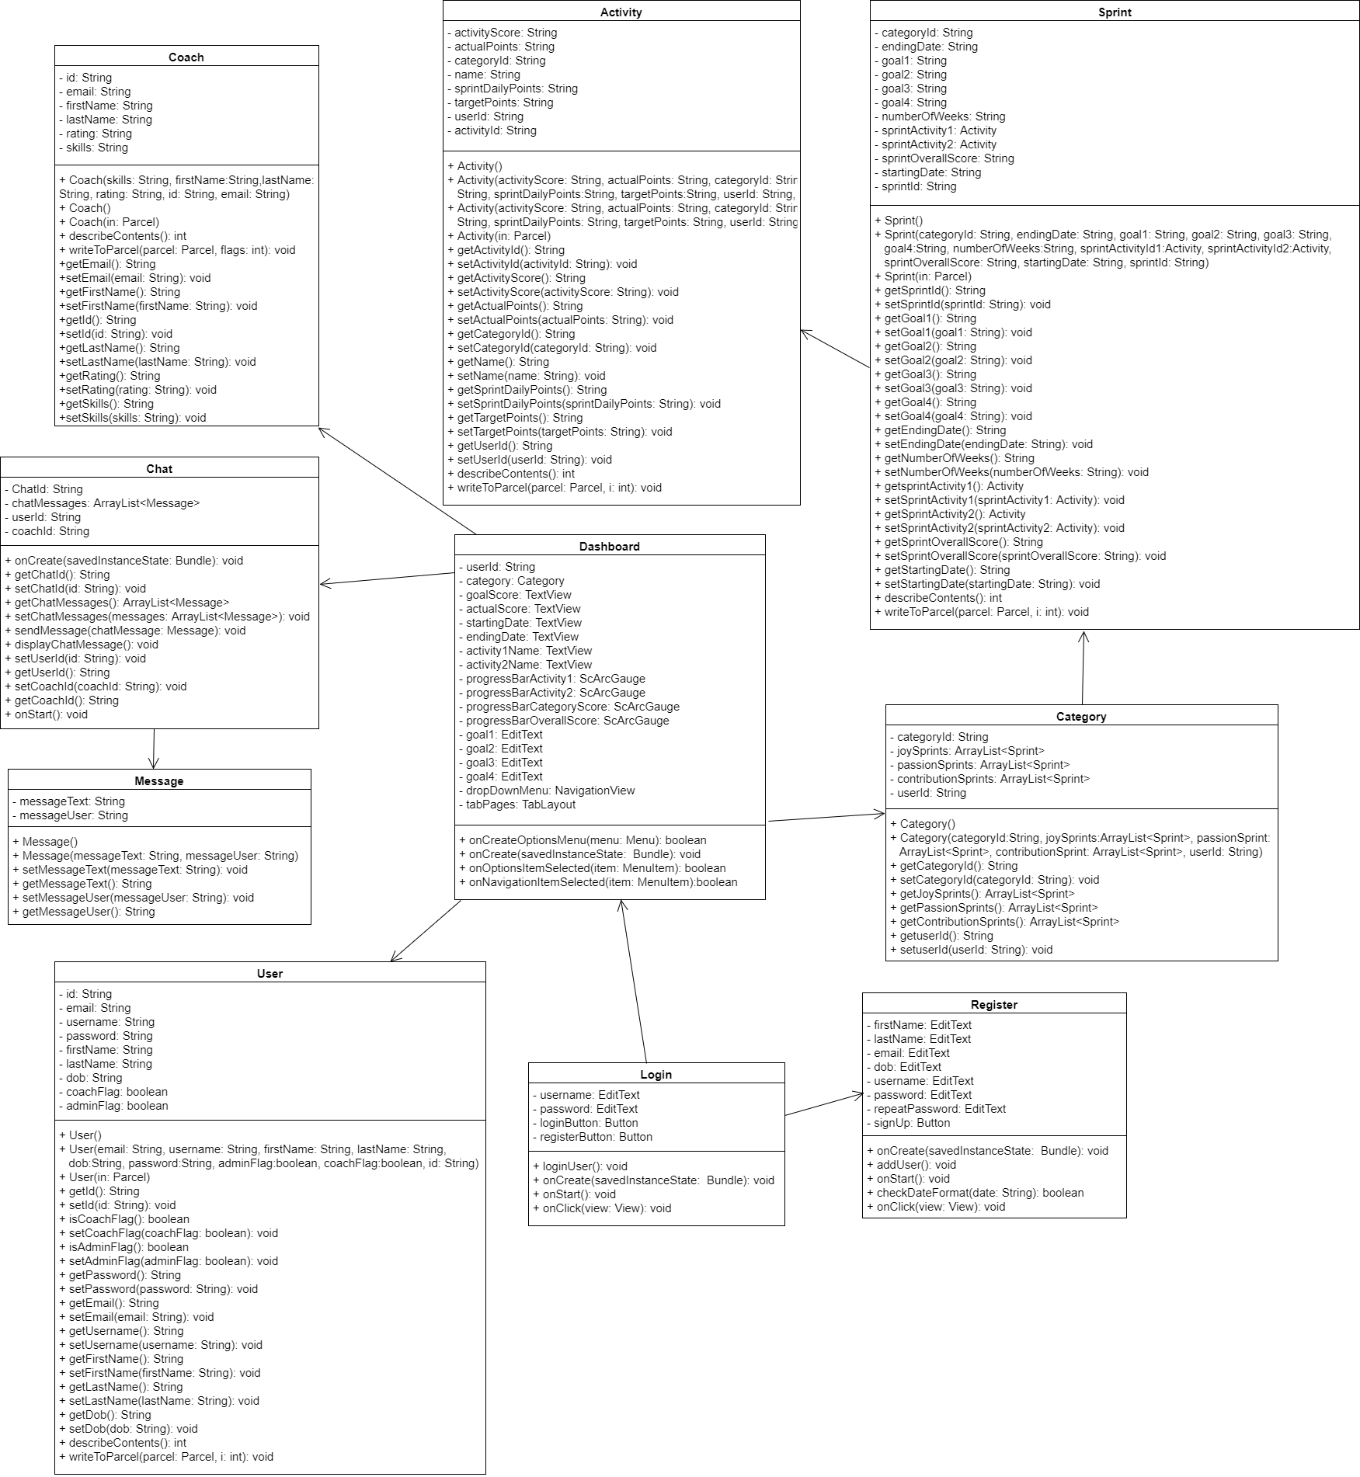
Class Diagram

Slide 8



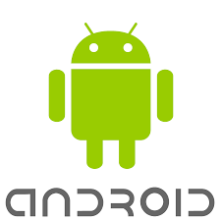



Implementation
Application was developed using Android Studio 2.3.3 IDE (Android version) and XCode 8.3 (iOS version)
Java as programming language in combination with Android SDK tools (Android version)
Swift as programming language in combination with IOS SDK tools (iOS version)
XML (Android) and XIB (iOS) for defining User Interface
Firebase Realtime Database for data storage and synchronization
Agile project management using Mingle
Git for source control

Slide 9
User Stories
Sign in to the application
View user’s dashboard
Visualize user’s progress
Select activities that bring sense of Joy
Set up new sprint and save settings
View current cycle
View previous cycle
View life coaches
Select and communicate with coaches
Safely sign out of the application

Slide 10
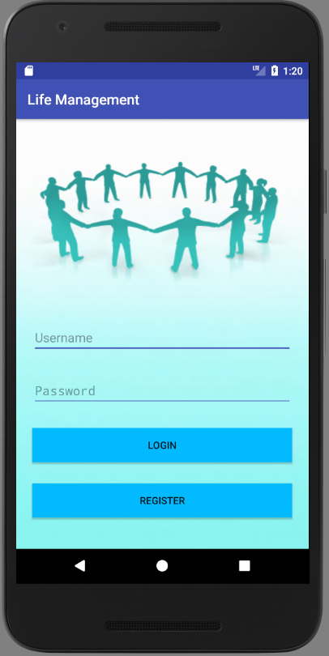
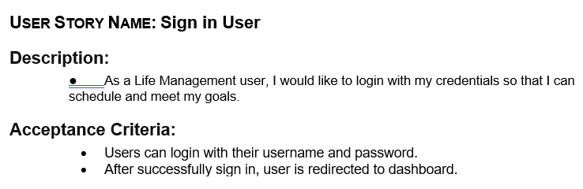
User Story 1 Description

Slide 11
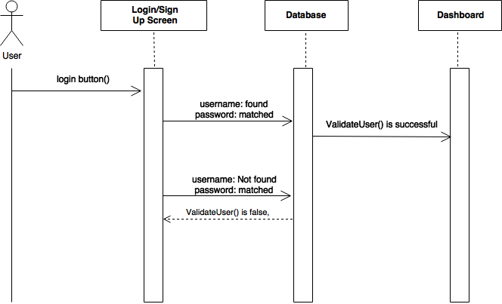
User Story 1 Implementation

Slide 12
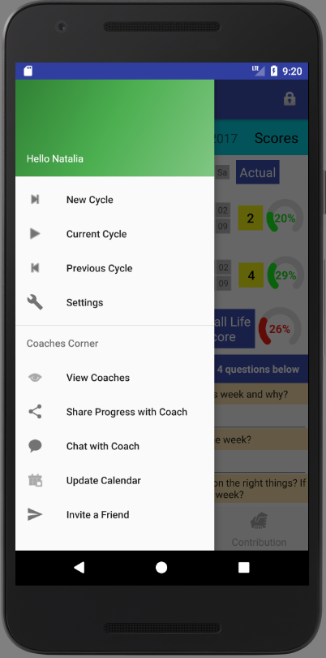
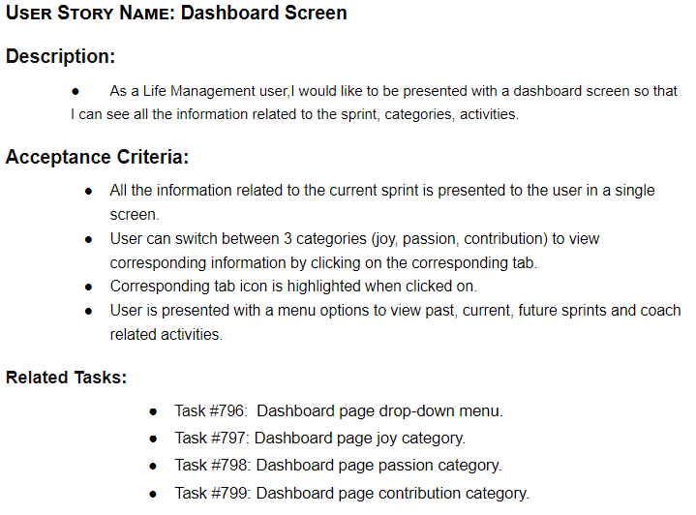
User Story 2 Description

Slide 13
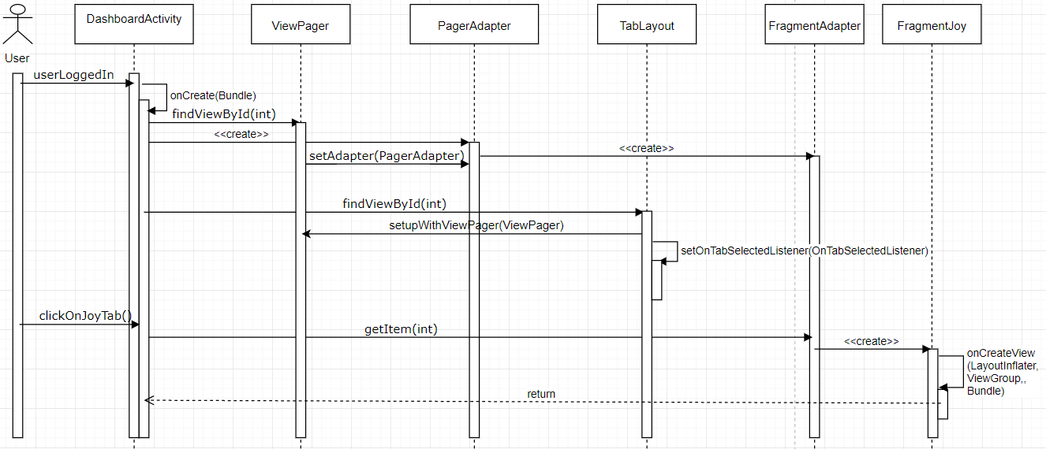
User Story 2 Implementation

Slide 14
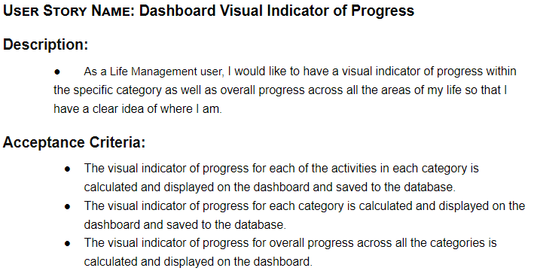
User Story 3 Description

Slide 15
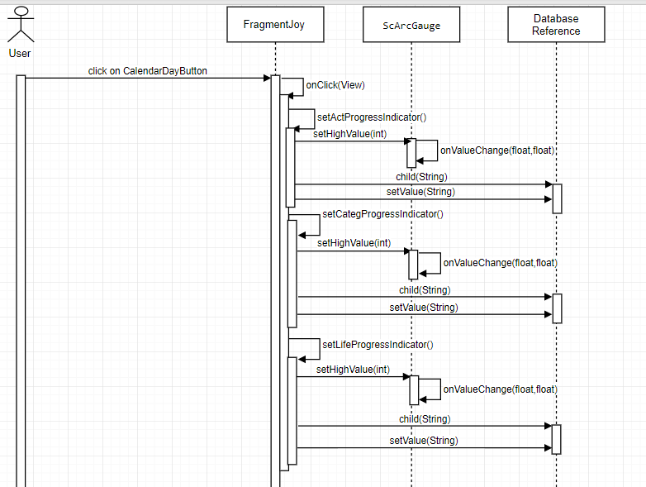
User Story 3 Implementation

Slide 16
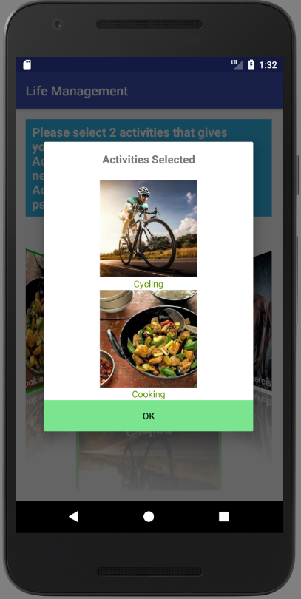
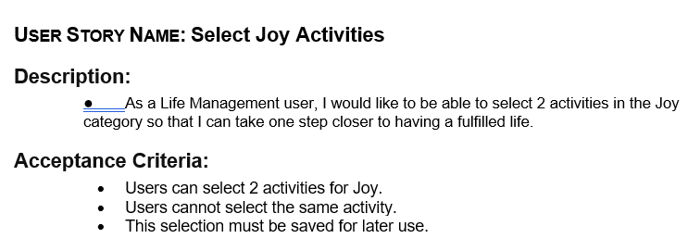
User Story 4 Description

Slide 17
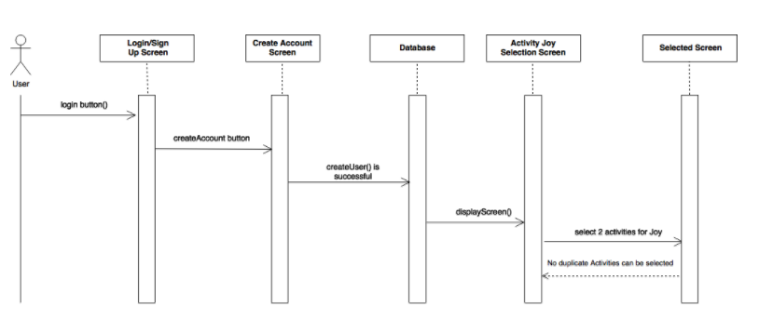
User Story 4 Implementation

Slide 18
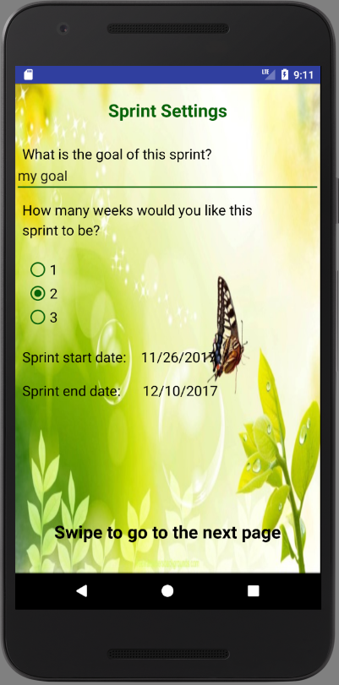
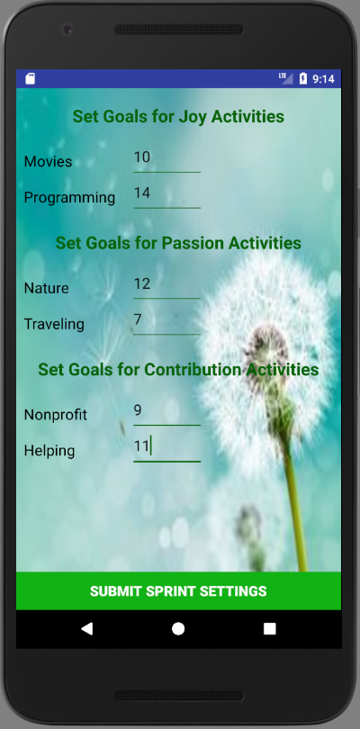
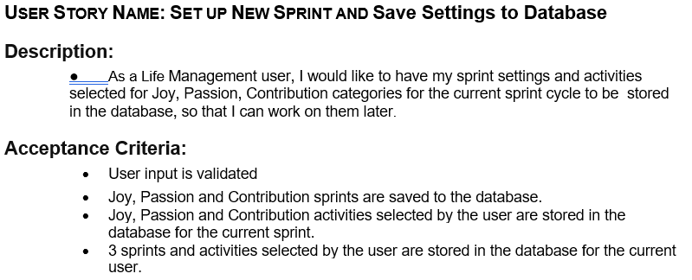
User Story 5 Description

Slide 19
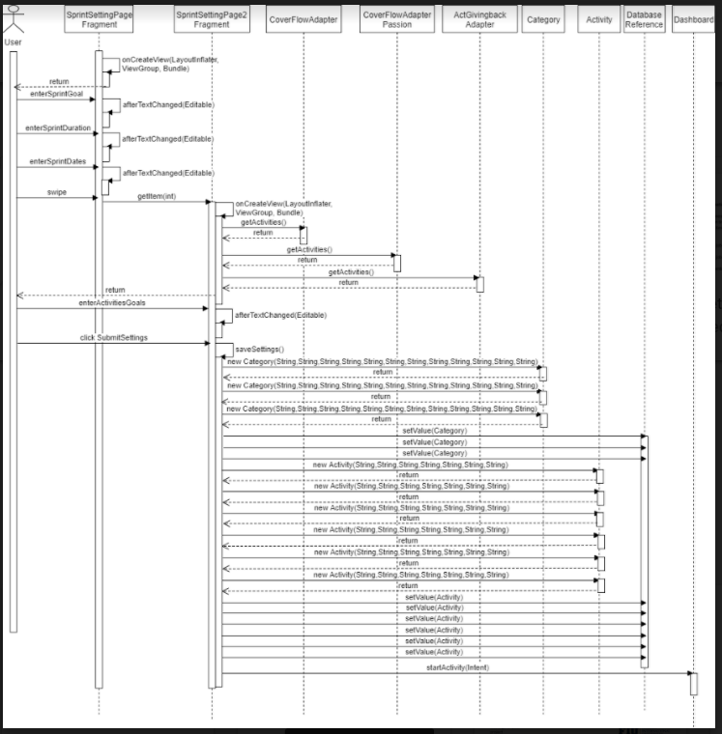
User Story 5 Implementation

Slide 20
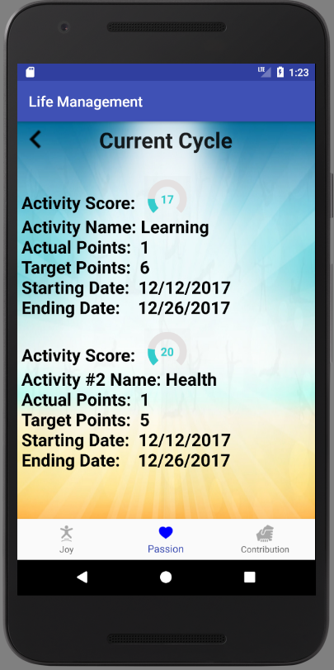
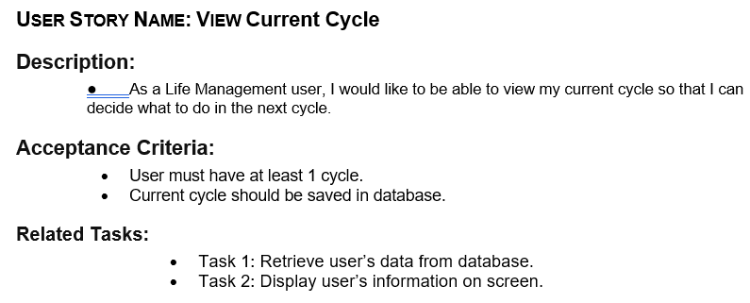
User Story 6 Description

Slide 21
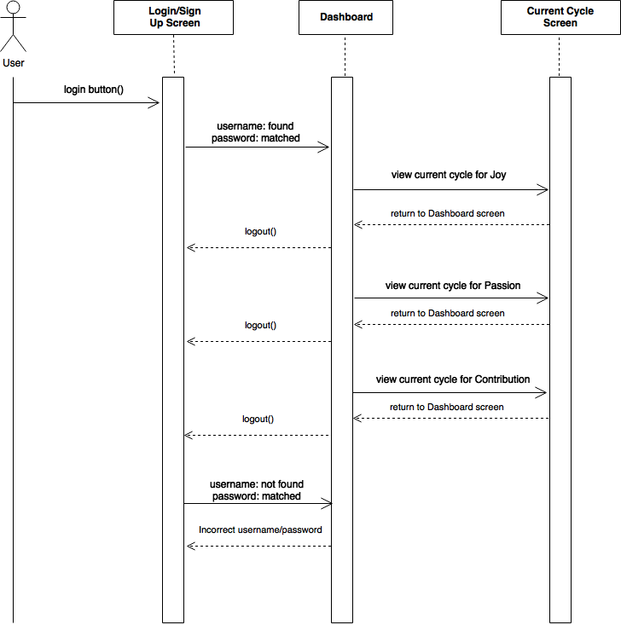
User Story 6 Implementation

Slide 22
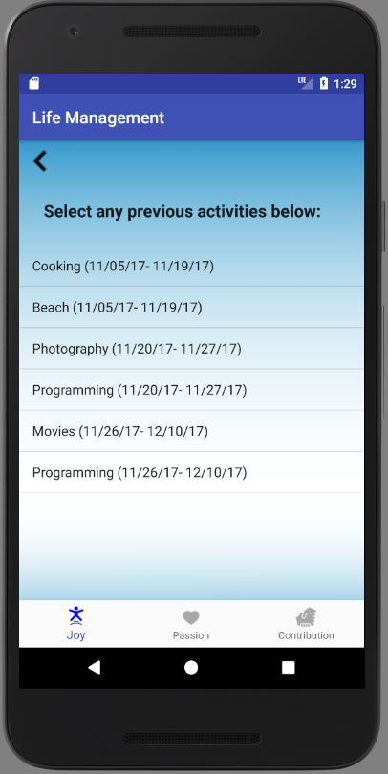
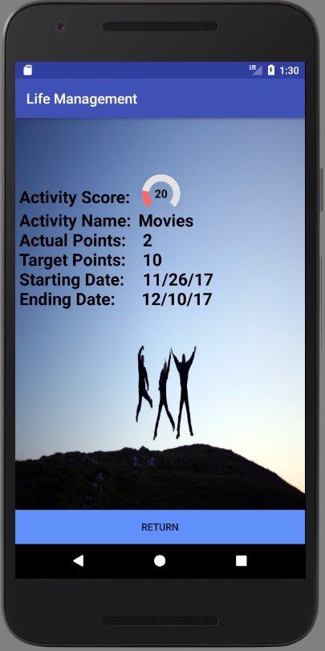
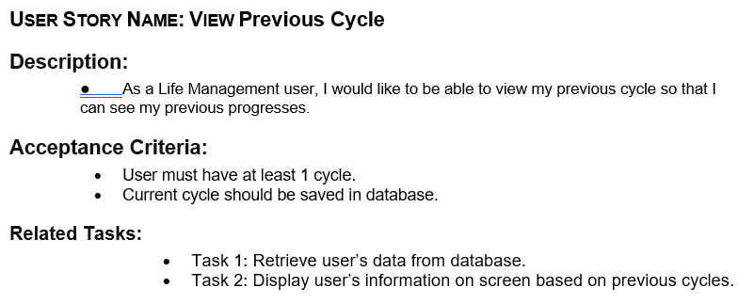
User Story 7 Description

Slide 23
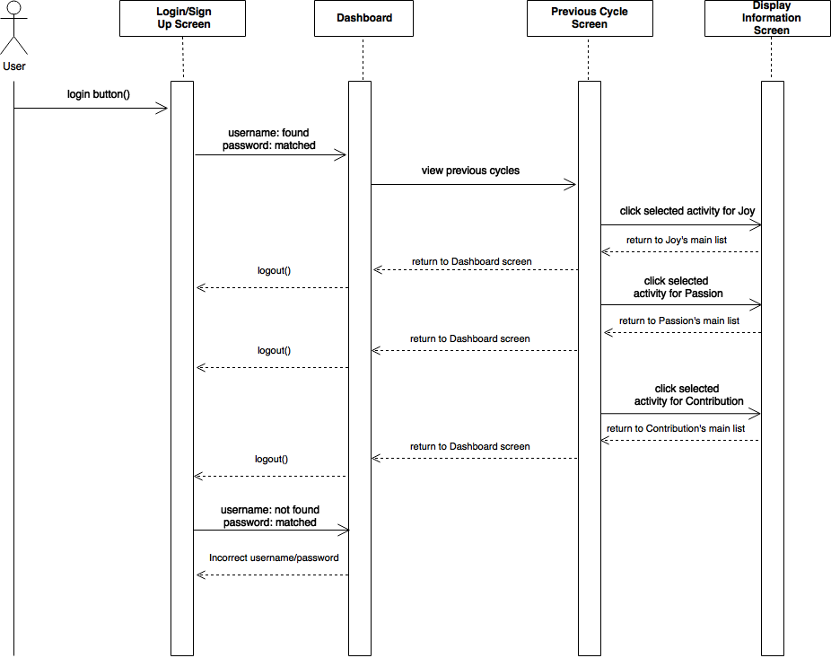
User Story 7 Implementation

Slide 24
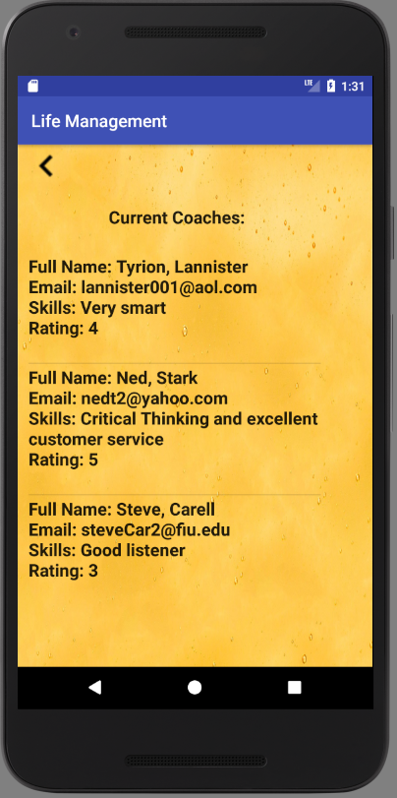
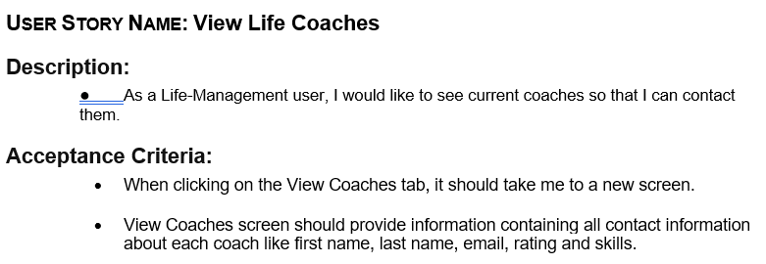
User Story 8 Description

Slide 25
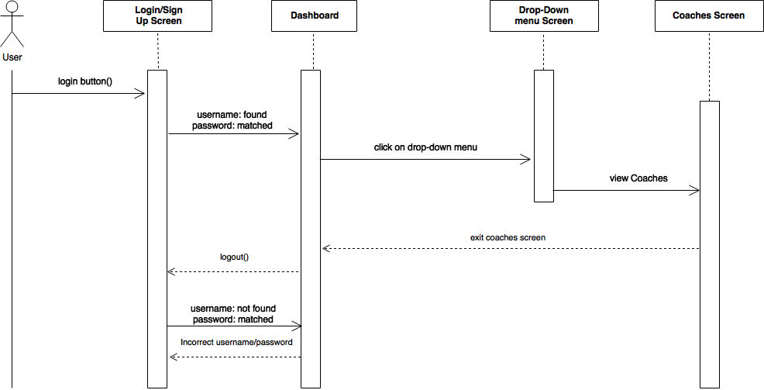
User Story 8 Implementation

Slide 26
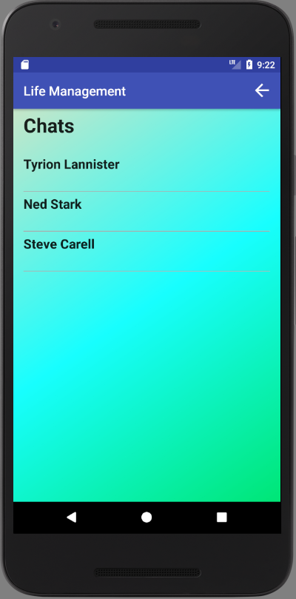
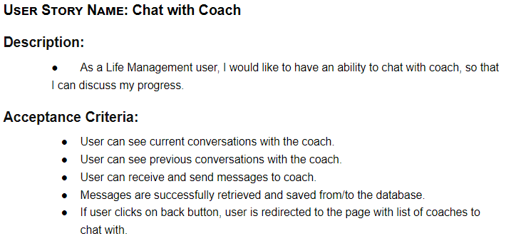
User Story 9 Description

Slide 27
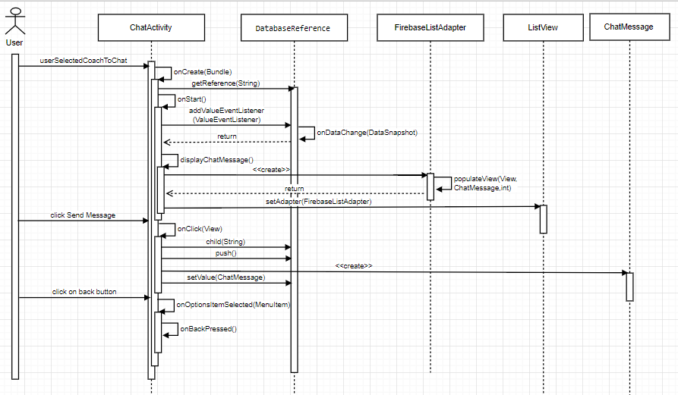
User Story 9 Implementation

Slide 28
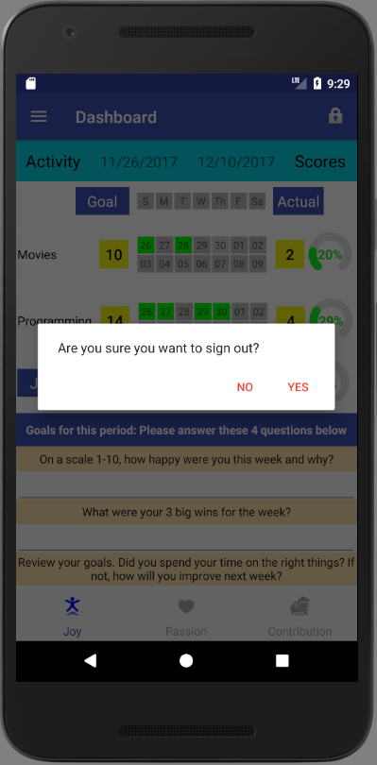
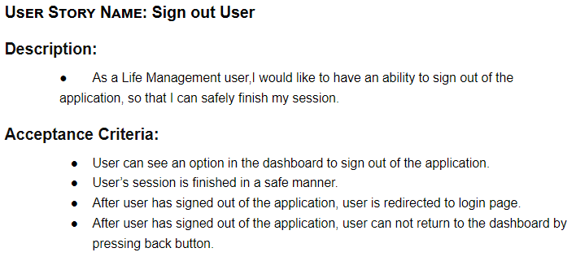
User Story 10 Description

Slide 29
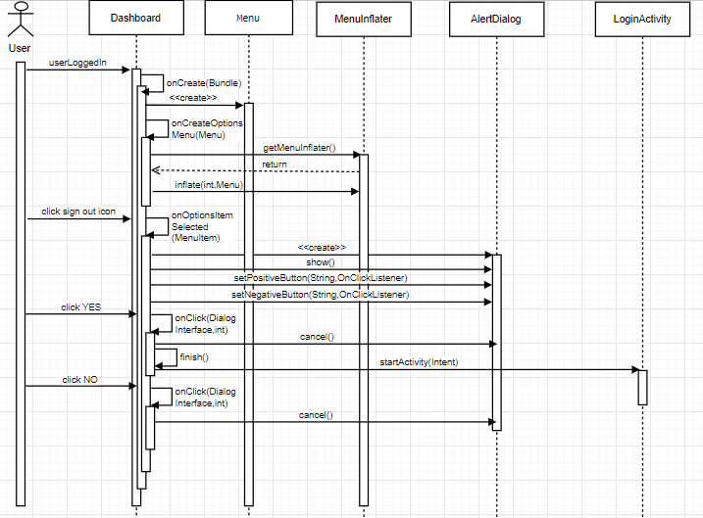
User Story 10 Implementation

Slide 30
Verification
Unit testing was performed for each user stories
Integration testing was performed throughout application development
Usability testing were performed by letting friends use the application and getting their feedback
Product owner validated the system during our bi-weekly meetings where we demo the application

Slide 31
Summary
Life Management Mobile App helps users find happiness and purpose in life in a fun and engaging way
Users can update, visualize and assess their progress to make necessary adjustments in their life
Users can communicate with life coaches for support and guidance
THANK YOU FOR YOUR ATTENTION!

